Slide 1
An Explainable machine learning framework for university students dropout prediction and risk factor analysis
Arnob Das
ID : 0242310005101361
And
Md. Shazzadur Rahman Piash
ID : 024231005101583
Department of CSE
Daffodil International University

Slide 2
Outline
Introduction
Background Study/Literature Review
Gap Analysis
Objective and Motivation
Novelty of this Study
Datasets, Tools and Techniques
Proposed Methodology
Expected Outcomes
Q & A

Slide 3
Introduction
Current dropout prediction systems are highly accurate, but they often work as "black boxes," making their predictions difficult to understand. Universities can identify at-risk students but cannot clearly determine whether the risk is caused by academic performance, attendance, or financial issues. To address this problem, this project combines Deep Learning (LSTM) with Explainable AI (SHAP) to provide accurate, transparent, and easy-to-understand student dropout predictions.
The Impac

Slide 4
Background Study/Literature Review
Reference | Title | Authors | Publication Year | Dataset & Size | Methodology / Algorithms | Key Features / Inputs | Performance Metrics | Explainability (XAI) | Limitations / Future Work
[1] | Long Short-Term Memory (LSTM) Based Model for Forecasting of Students' Dropout | Isah Yunusa Umar, K.I. Musa, Muhammad Tella | 2025 | Student data (attendance, GPA, admission grade, GDP, unemployment) | LSTM Network | Sequence input layer, LSTM layer, fully connected layer | High accuracy, noticeable clustering patterns for target classes | Not specified / None | Did not explore explainability (XAI) for predictions
[2] | Forecasting Student Dropout (Analysis of Registration and Demographics) | Johannes Berens, Kerstin Schneider, Simon Gortz, S. Oster, J. Burghoff | 2019 | Large dataset (graduates ~1000+, dropouts ~1000+ per semester) | Regression models, ROC AUC analysis | Semester-wise enrollment, performance over 4 semesters | Accuracy ranges from 63.47% (1st sem) to 93.76% (4th sem) | None | Static modeling; requires multi-semester tracking for high accuracy
[3] | Big Data and Analytics / Prediction of student's performance | Zohair, L.M.A. et al. (applsci-11-00237-v3) | 2020 | Small dataset size modeling / Survey based | Educational Data Mining, Prediction Models | Indirect assessments, major types | N/A | None | Focuses on small dataset size and general analytics
[4] | Addressing student dropout in developing countries | Neema Mduma | 2023 | Uwezo (Tanzania, 61,340 samples) & India dataset (11,257 samples) | Machine Learning for highly imbalanced data | Pupil Teacher Ratio, Income, Parent interaction, Latrines ratio | Dealt with high imbalance (1.6% to 4.9% dropout rate) | None | Highly imbalanced data, needed heavy pre-processing and imputation
[5] | Predicting Student Dropouts using High School and Entrance Exam Data | Marcell Nagy, Roland Molontay | 2023 | Sensitive University Data | Machine Learning Models | Math score, Chosen subject score, High school GPA, Language cert, Gender | Evaluated based on feature importance and average absolute impact | Feature Importance tracking | Data is highly sensitive and restricted
[6] | Prediction of Students' Adaptability Using Explainable AI in Educational Machine Learning Models | Leonard Chukwualuka Nnadi, Yutaka Watanobe, et al. | 2023 | Kaggle Dataset (Students' adaptability level in online education) | Educational Machine Learning Models + XAI | Demographics, Network type, Device, Financial condition | High accuracy in adaptability prediction | Yes (Explainable AI used) | Focused mainly on online education adaptability rather than absolute dropout
[7] | Predicting student dropout using Moodle activity trends | M. Vaarma and H. Li | 2024 | University student records (Moodle logs, demographics) | Predictive Modeling with normalized variables | Moodle activity trend, Months absent, Accumulated credits, Failed courses | Calculated Spearman correlations | None | Dependent heavily on active Moodle usage logs
[8] | Early Prediction of Student Dropout based on Machine Learning | Carlos Kemper et al. | 2020 | University student records (15k+ records) | Random Forest and Decision Trees | Academic performance, Demographics | Accuracy ~88% | None | Does not capture temporal changes in student behavior
[9] | Student Dropout Prediction using Deep Learning Techniques | S. Kim et al. | 2022 | Online learning platform data | Deep Neural Networks (DNN) | Video watch time, Quiz scores, Assignment completion | Accuracy ~91% | None | Lack of transparency in the model's decision making
[10] | Interpretable Machine Learning for Student Dropout Risk Assessment | A. Sharma and P. Kumar | 2023 | Higher education dataset (5k+ records) | XGBoost with SHAP | Socioeconomic status, First-semester grades, Attendance | ROC-AUC 0.89 | Used SHAP for feature contributions | Focused on static features rather than dynamic multi-semester data

Slide 5
Gap Analysis
Most existing studies use only static or single-semester data.
They cannot track students' academic progress over multiple semesters.
Deep learning models provide high accuracy, but their decisions are difficult to explain.
Explainable AI (XAI) is mostly used with traditional machine learning models, not with sequential deep learning.
Our proposed system combines LSTM and SHAP to provide accurate, transparent, and multi-semester student dropout prediction.

Slide 6
Objective and Motivation
Motivation:
Student dropout is a major challenge in higher education.
Early prediction enables timely intervention and improves student retention.
Traditional machine learning models often lack interpretability.
Explainable AI can provide transparent predictions and identify key dropout risk factors.
Objectives:
Predict university student dropout using machine learning models.
Compare the performance of traditional machine learning models and LSTM.
Identify the key factors influencing student dropout.
Explain model predictions using SHAP to support informed intervention strategies.

Slide 7
Novelty of this Study
Develops an explainable machine learning framework for university student dropout prediction.
Combines predictive modeling with SHAP to provide transparent and interpretable predictions.
Compares traditional machine learning models with a deep learning (LSTM) model using the same dataset.
Identifies the most influential academic, demographic, and financial risk factors contributing to student dropout.
Supports early intervention strategies by providing actionable insights for educators and university administrators.

Slide 8
Datasets, Tools and Techniques
Data | Tools | Techniques
Dataset: Predict Students Dropout and Academic Success (UCI) | Python | Exploratory Data Analysis (EDA)
4,424 student records | Jupyter Notebook | Data Preprocessing
36 features + 1 target | Pandas & NumPy | Feature Encoding
Classes: Dropout, Graduate, Enrolled | Matplotlib & Seaborn | Train-Test Split (80:20)
Demographic, Academic, Financial & Socioeconomic features | Scikit-learn, VS Code, GitHub | Random Forest (Baseline), Performance Evaluation

Slide 9
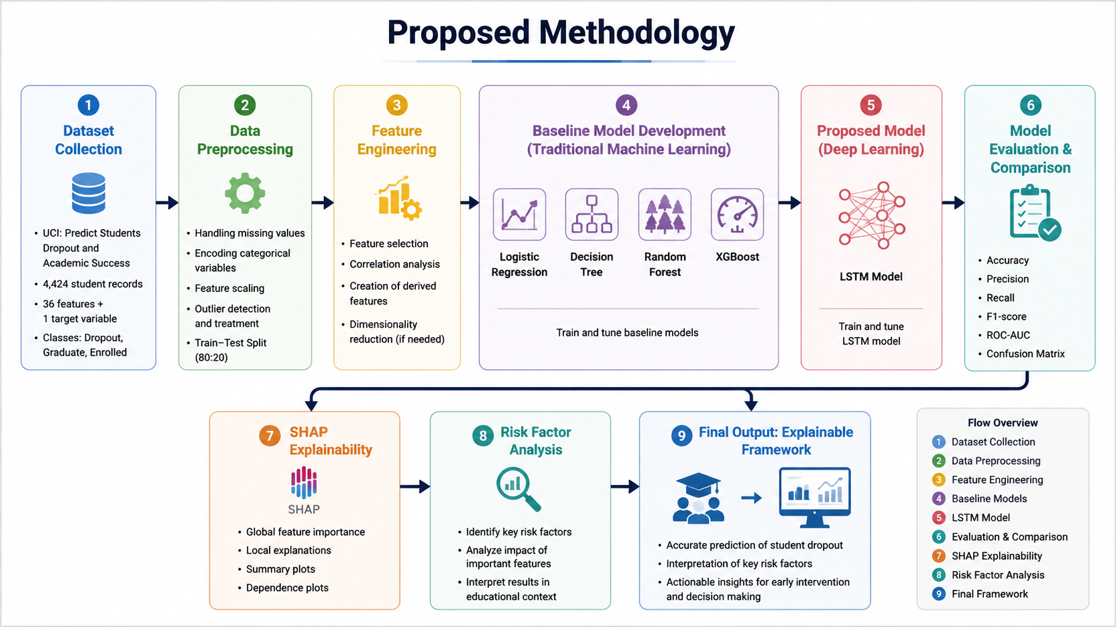
Proposed Methodology

Slide 10
Expected Outcomes
Develop an accurate and explainable machine learning framework for predicting university student dropout.
Compare the performance of traditional machine learning models and the LSTM model.
Identify the key academic, demographic, financial, and socioeconomic factors influencing student dropout.
Provide transparent model explanations using SHAP to support understanding of prediction decisions.
Generate insights that can assist universities in early intervention and improving student retention.

Slide 11
THANK YOU

